Slide 1
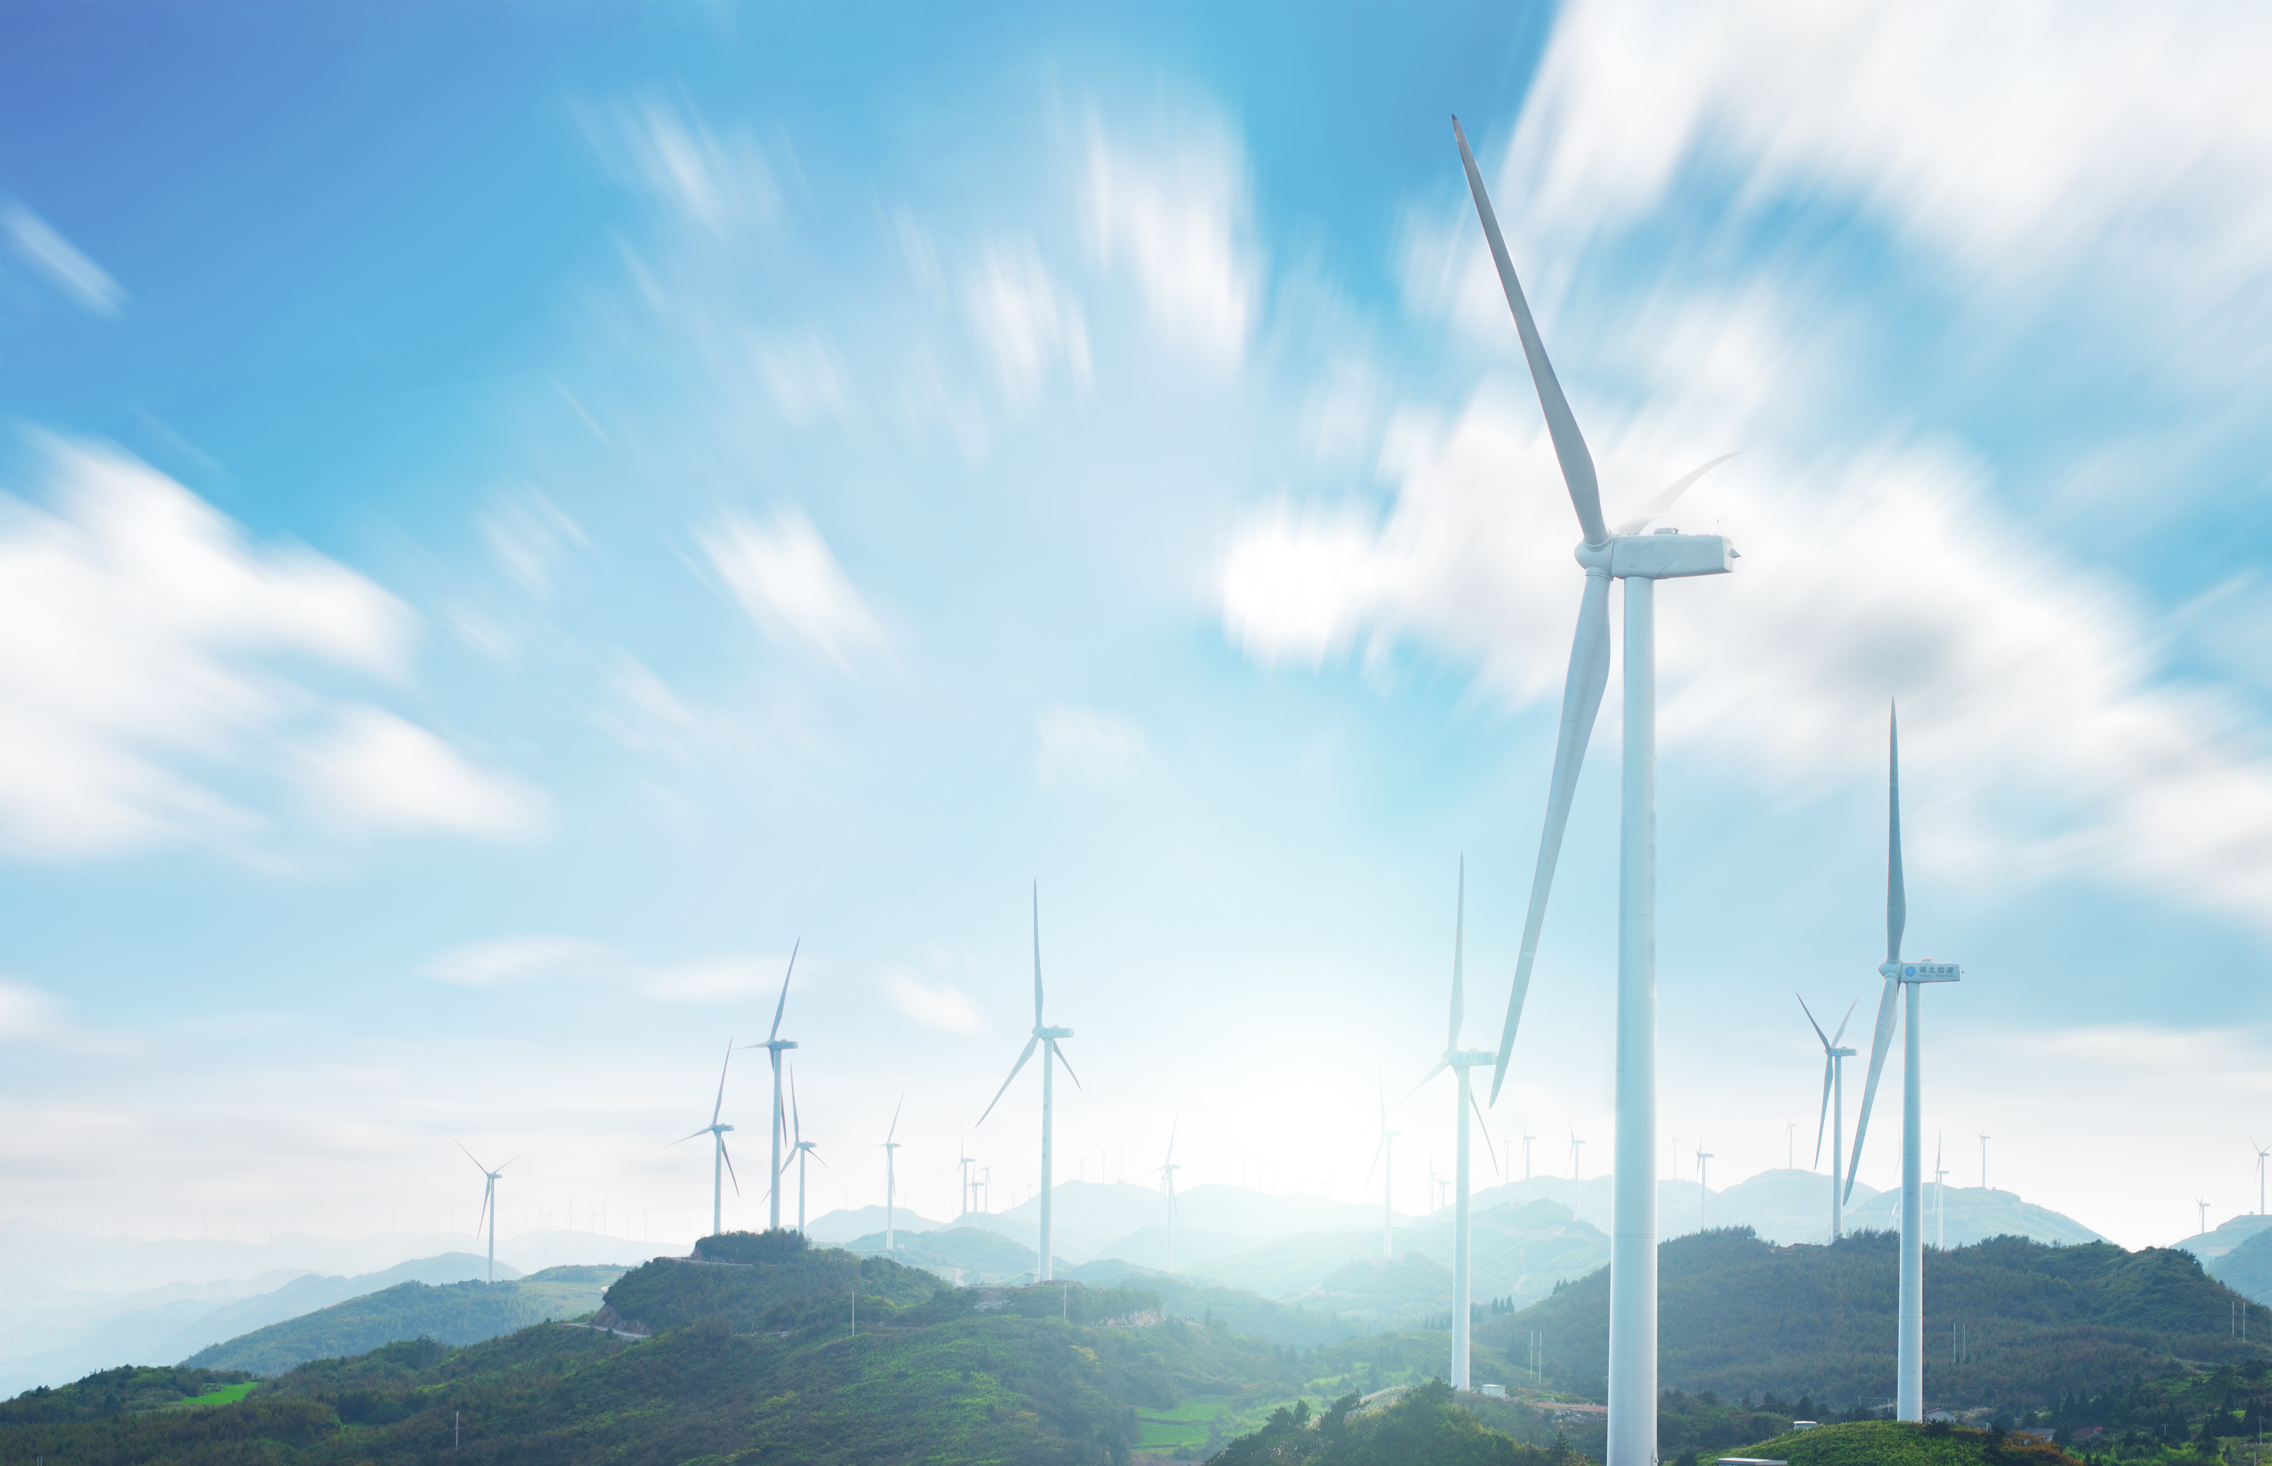
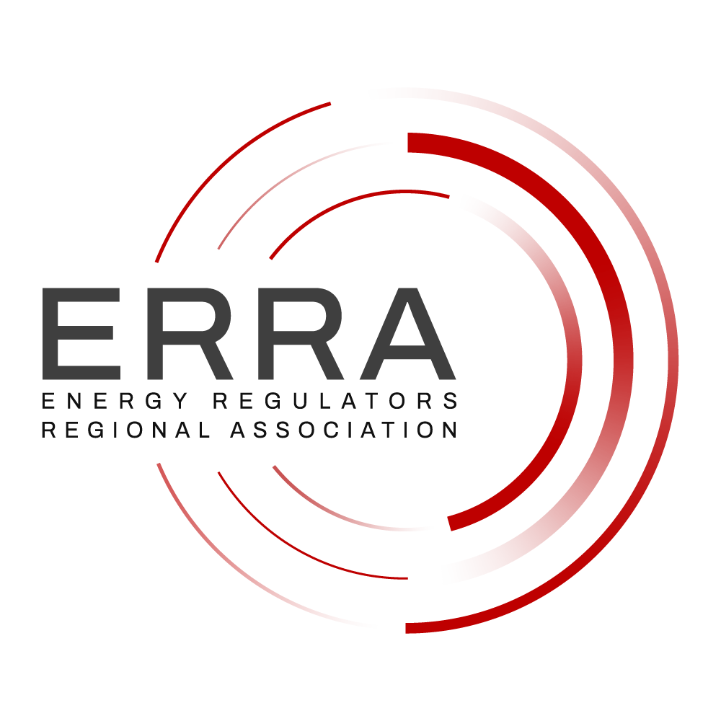


ICER Distinguished Scholar Award
Next Practices Category
Luca Lo Schiavo
ERRA Research Unit
Tbilisi, Closing Session 24 Sept.2026

Slide 2
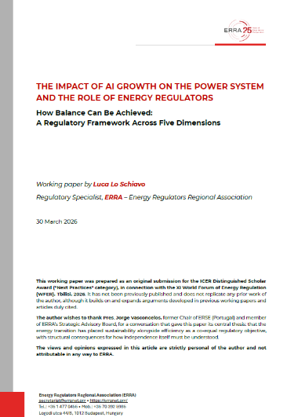
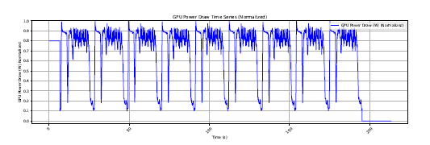
ERRA Research Paper: The Impact of AI Growth on the Power System
Four substantive dimensions
long-term predictability
operational reliability
economic affordability
and environmental sustainability
Session 5d
Source: NERC, Characteristics and Risks of Emerging Large Loads, July 2025
https://erranet.org/research-papers/

Slide 3
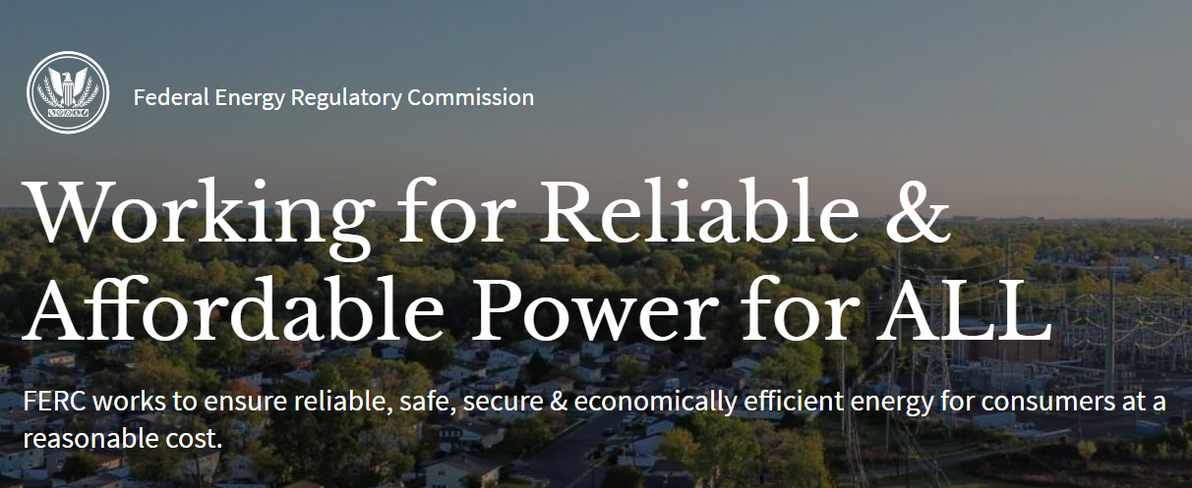
ERRA Research Paper: The Impact of AI Growth on the Power System
Four substantive dimensions
long-term predictability
operational reliability
economic affordability
and environmental sustainability
https://erranet.org/research-papers/

Slide 4
ERRA Research Paper: The Impact of AI Growth on the Power System
Four substantive dimensions
long-term predictability
operational reliability
economic affordability
and environmental sustainability
regulatory independence, that cuts across all four: the institutional condition that determines whether (and which) governance of the other four is possible at all
A fifth dimension
https://erranet.org/research-papers/

Slide 5
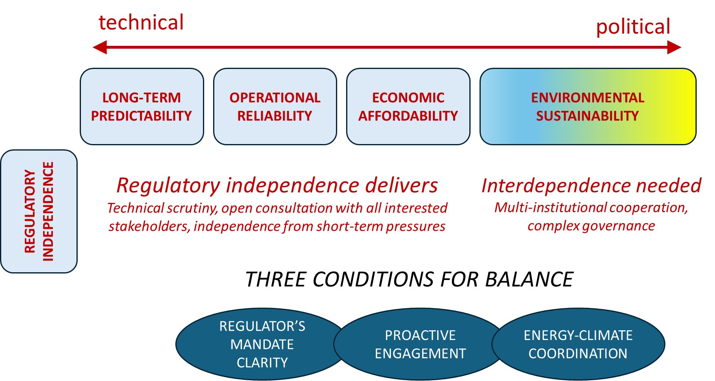
ERRA Research Paper: The Impact of AI Growth on the Power System

Slide 6
How Balance Can Be Achieved
[New services] contemplate running the system “tighter” than we have done in the past. (…) While it is important to identify innovative solutions that can adapt to the needs of the system, the Commission and grid operators must also be careful not to implement changes that create unforeseen reliability risks. Ultimately, we must find the proper balance (and I would argue we are exploring a new balance) between costs of investments versus reliability”
FERC Commissioner Judy Chang
Concurrent Statement, June 18, 2026

Slide 7
Help Protect the Common Home
101. (…) Current AI systems require enormous amounts
of energy and water, significantly influencing carbon dioxide emissions, and place heavy demands on natural resources. As their complexity increases, especially in the case of large language models, the need for computing power and storage capacity grows too, which requires an extensive network of machines, cables, data centers and energy-intensive infrastructure. For this reason, it is essential to develop more sustainable technological solutions that reduce environmental impact and help protect our Common Home.
Encyclical Letter MAGNIFICA HUMANITAS
of His Holiness Pope Leo XIV

Slide 8
luca.loschiavo@erranet.org

